Slide 1


IT359 PATTERN RECOGNITION
PROJECT
COMPARATIVE ANALYSIS OF VIEWS ON MODERN ISSUES IN RELIGIOUS TEXTS USING NLP TECHNIQUES
211AI001 - A D MAHIT NANDAN
211AI020 - ISHAN GODBOLE
211AI026 - PRANAV KAPPARAD

Slide 2

INTRODUCTION
Religious texts have shaped human cultures, morals, and ethics, and provide insights into universal human concerns such as justice, morality, and societal values.
Interpretations of religious texts have evolved over time, reflecting the changing priorities of societies.
Analysis of these texts using NLP techniques helps uncover hidden patterns, themes, and sentiments in them.
In this project, we will apply techniques such as topic modelling, sentiment analysis and semantic analysis on these texts to analyze them.
We also aim to perform a comparative study on the sentiments of these texts on various modern issues such as human rights, gender roles, violence and peace, freedom of speech, etc.

Slide 3
LITERATURE SURVEY
TITLE | Authors | Description | Findings
Modeling the Sacred: Considerations When Using Religious Texts in NLP (2024) | B. Hutchinson | Discusses ethical considerations when applying NLP to religious texts, with a focus on machine translation and sentiment analysis. | Emphasized the importance of sensitivity when handling sacred writings for NLP tasks like sentiment analysis.
Large language model for Bible sentiment analysis: Sermon on the Mount (2024) | Mahek Vora, Tom Blau, Vansh Kachhwal, Ashu M. G. Solo, Rohitash Chandra | Use sentiment and semantic analysis to study and compare certain chapters of the Bible verse-by-verse | Varying levels of humor, optimism, and empathy in the respective chapters of the Bible were detected.
Artificial Intelligence for Topic Modelling in Hindu Philosophy (2022) | R. Chandra, M. Ranjan | Applied AI for topic modeling between Upanishads and Bhagavad Gita to map key themes. | Successfully identified thematic connections between the Upanishads and Bhagavad Gita using topic modeling techniques.
Semantic and Sentiment Analysis of Selected Bhagavad Gita Translations Using BERT (2022) | R. Chandra, V. Kulkarni | Performed semantic and sentiment analysis on Bhagavad Gita translations using BERT-based models. | Showed how BERT-based analysis can provide deeper insights into semantic and emotional dimensions of Bhagavad Gita.

Slide 4
LITERATURE SURVEY
TITLE | Authors | Description | Findings
Computational and natural language processing based studies of hadith literature: a survey (2019) | Aqil M. Azmi, Abdulaziz O. Al-Qabbany, Amir Hussain | Surveys major works applying computational and NLP techniques to hadith studies. Categories include content-based studies, narration-based studies, and overall studies. | Reviews pioneering works in hadith analysis using NLP, introduces sentiment and emotion mining for future research.
Extracting Knowledge from the Bible: A Comparison between the Old and the New Testament (2019) | Ramona Cristina Popa, Nicolae Goga, Maria Goga | Compares the Old Testament and New Testament using ontology learning and knowledge extraction techniques. Text2Onto is used to extract relevant concepts from each. | Revealed differences in size, practice, prophecy, and time period, with some similarities between the two texts. No prior studies in this domain.
Finding Answers from the Word of God: Domain Adaptation for Neural Networks in Biblical Question Answering (2018) | Helen Jiahe Zhao, Jiamou Liu | Implements question-answering based on verses from the Bible, create a new dataset BibleQA based on bible trivia questions and propose three neural network models | Achieved good results with shorter context lengths compared to longer; more modern translations give better results

Slide 5
PROBLEM STATEMENT
The research aims to employ advanced Natural Language Processing techniques for topic modeling to discover the underlying themes present in various religious texts.
A comparative analysis will be conducted to examine the similarities and differences among these texts, revealing how different religious perspectives approach common themes.
Sentiment analysis will be performed to assess the texts’ viewpoints on modern topics such as gender roles, violence, human rights, and freedom of speech.

Slide 6
METHODOLOGY
WORD FREQUENCY AND TOPIC MODELLING
Word Frequency Analysis: A comprehensive word frequency analysis will be conducted to identify the most commonly used words and recurring concepts across each text. This will provide a foundational understanding of thematic elements in the corpus.
Latent Dirichlet Allocation (LDA): LDA will be used to identify latent topics within each text. After generating topics for each religious text, a comparative analysis will be performed to uncover common and unique themes across the corpus.
Additional topic modelling methods, such as BERTopic, may also be explored for more nuanced topic discovery.

Slide 7
METHODOLOGY
SENTIMENT ANALYSIS
VADER Sentiment Analysis: Sentiment analysis will be applied to the corpus using VADER, an unsupervised model that classifies text into positive, negative, and neutral sentiments. This will provide insights into the emotional tone of different sections of the texts.
Fine-tuning Sentiment Models: Given the formal and archaic nature of religious texts, sentiment analysis models may be fine-tuned on literary or religious data for better accuracy. Transformer-based models, such as BERT-based sentiment classifiers, may also be considered to capture more complex emotional expressions.

Slide 8
METHODOLOGY
WORD SHIFT GRAPHS
A word shift graph is a visualization that illustrates how the frequency or sentiment of specific words changes between two texts, highlighting which words contribute most to the overall shift in the data.
A proportion shift graph visualizes how the relative frequency of words changes between two texts, highlighting shifts in thematic focus.
An entropy shift graph measures the change in the variability or unpredictability of word usage between two texts, indicating differences in linguistic complexity.

Slide 9
METHODOLOGY
CORPUS DISTANCE MEASUREMENT
CompCor Tool: Use IBM's CompCor to measure semantic and syntactic distances, enabling quantitative comparison of religious texts based on content and language.
Cosine Similarity - The cosine similarity between the average embeddings of the Bible, Gita, and Quran was computed to measure textual similarity
Centroid Distance - The average cosine similarity and Euclidean distance between the cluster centroids of the Bible, Gita, and Quran were computed using KMeans clustering to analyze intertextual similarities and differences.

Slide 10
METHODOLOGY
THEMATIC INFERENCE ON MODERN SOCIAL TOPICS
Equality and Gender Equality: Use topic modeling and sentiment analysis to assess how gender roles and power dynamics are portrayed across texts, focusing on themes of equality and gender equality.
Religious Tolerance: Track mentions of other religions and use sentiment analysis to evaluate themes of tolerance or intolerance within each text.
Violence and Peace: Identify references to conflict, violence, or peace through topic modelling and sentiment analysis to understand each text’s stance on violence and conflict resolution.
Wealth Distribution: Analyse terms related to wealth and poverty to compare how each text addresses wealth distribution and socio-economic justice.

Slide 11
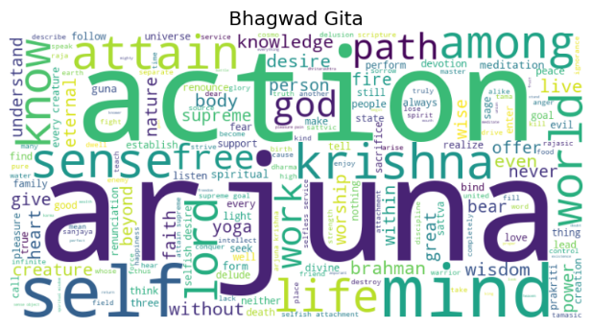
RESULTS
WORDCLOUDS

Slide 12
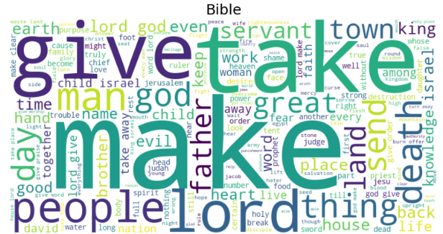
RESULTS
WORDCLOUDS

Slide 13
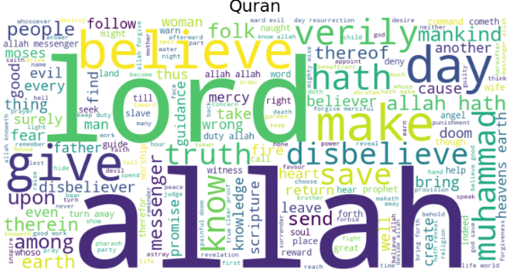
RESULTS
WORDCLOUDS

Slide 14
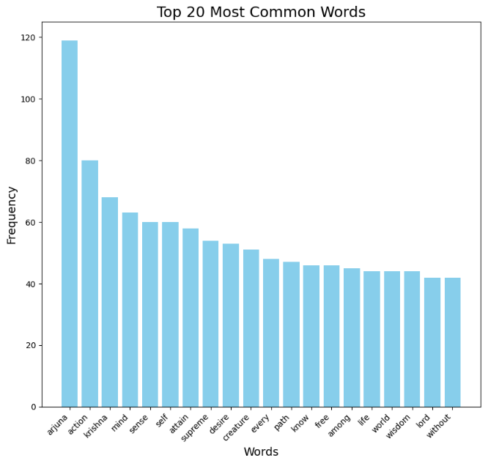
RESULTS
WORD COUNT of GITA

Slide 15
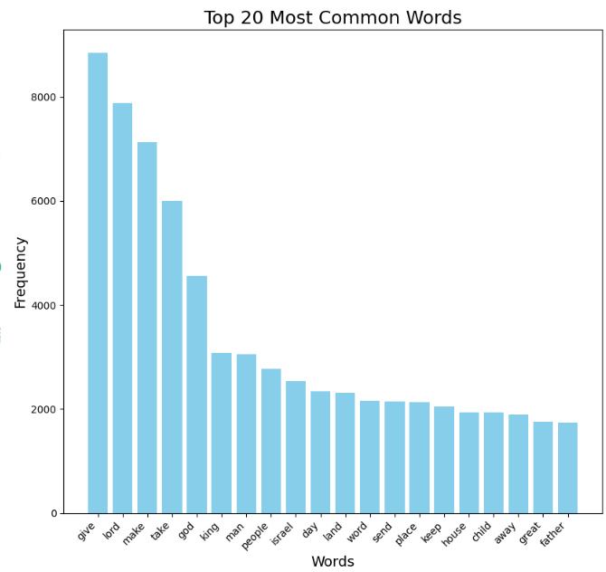
RESULTS
WORD COUNT of BIBLE

Slide 16
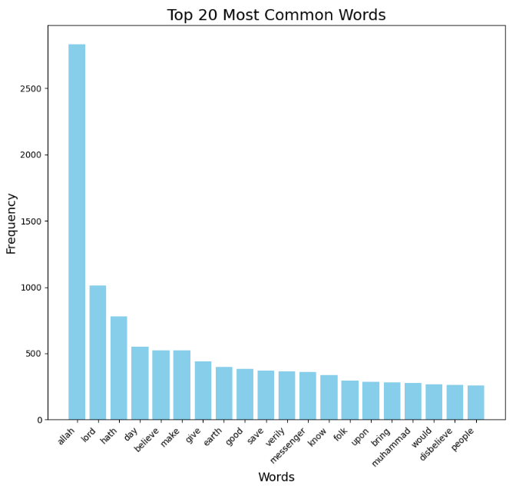
RESULTS
WORD COUNT of QURAN

Slide 17
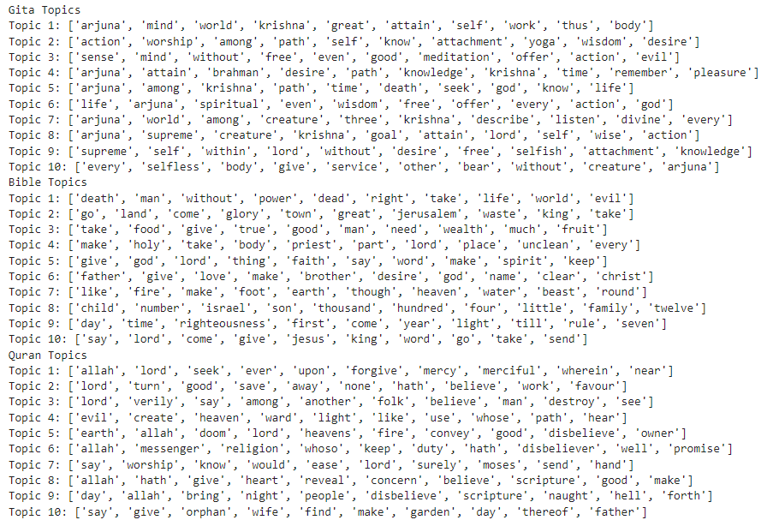
RESULTS
TOPICS using LDA

Slide 18
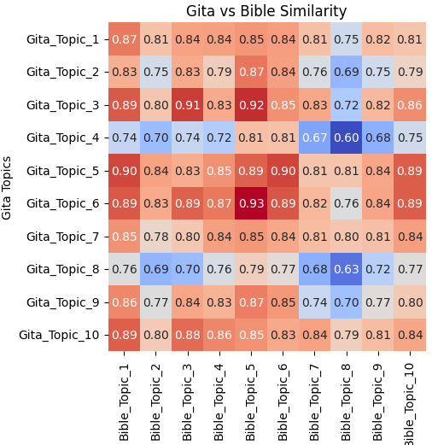
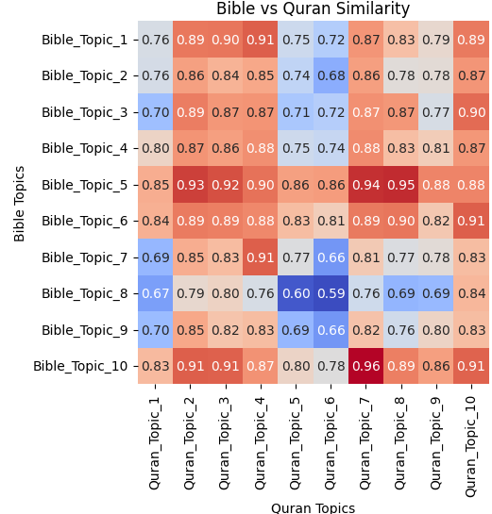
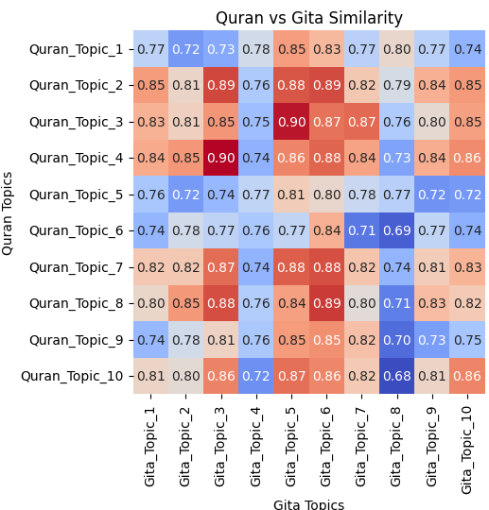
RESULTS
TOPICS SIMILARITY using LDA and GLOVE

Slide 19
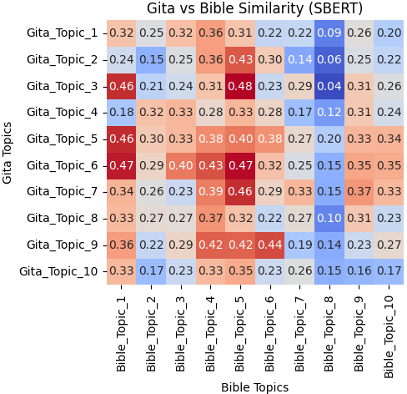
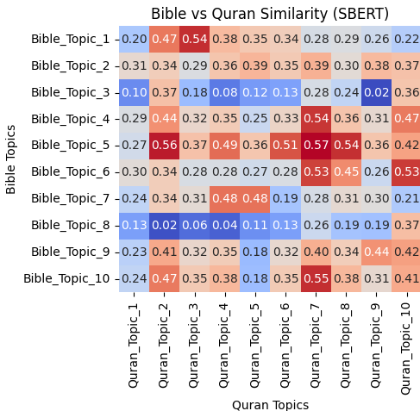
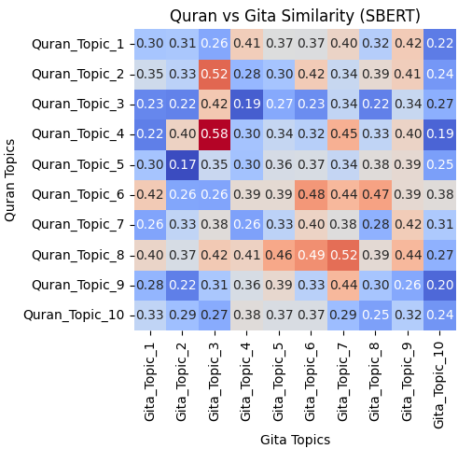
RESULTS
TOPICS SIMILARITY using LDA and Sentence Transformer

Slide 20
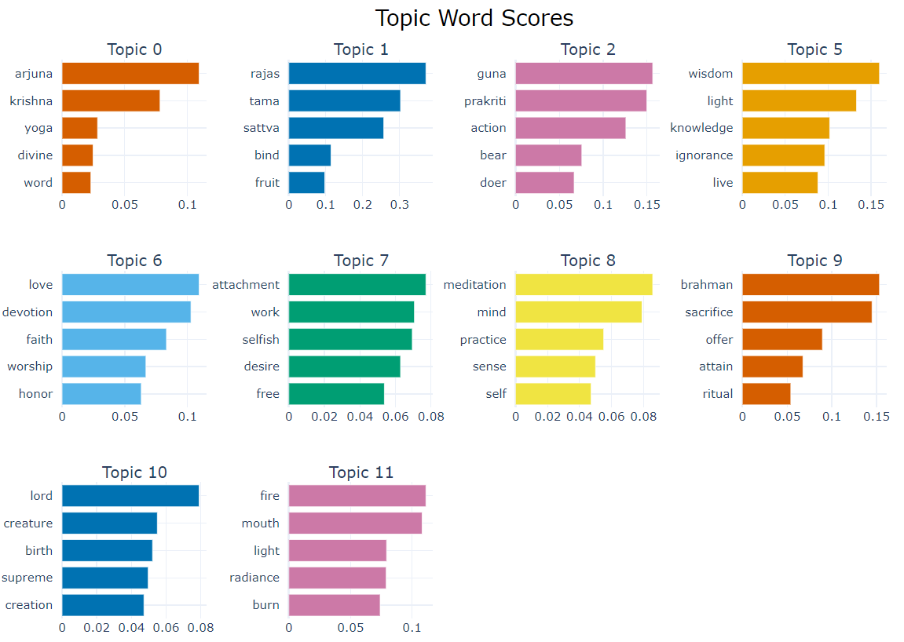
RESULTS
TOPIC WORD SCORES for GITA using BERTTOPIC

Slide 21
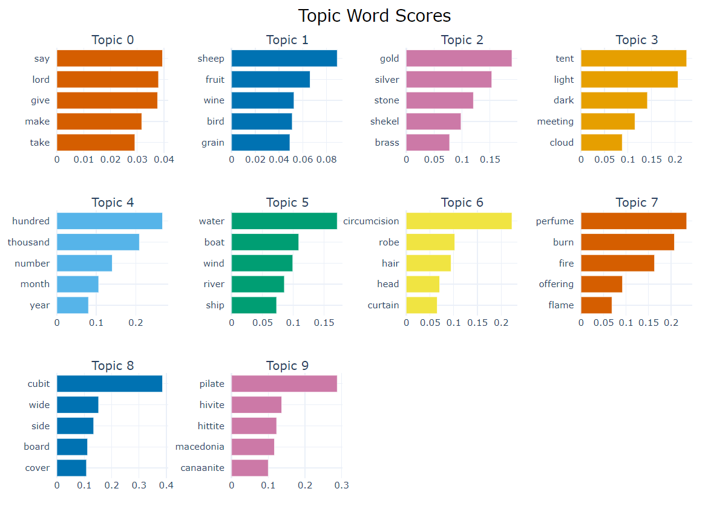
RESULTS
TOPIC WORD SCORES for BIBLE using BERTTOPIC

Slide 22
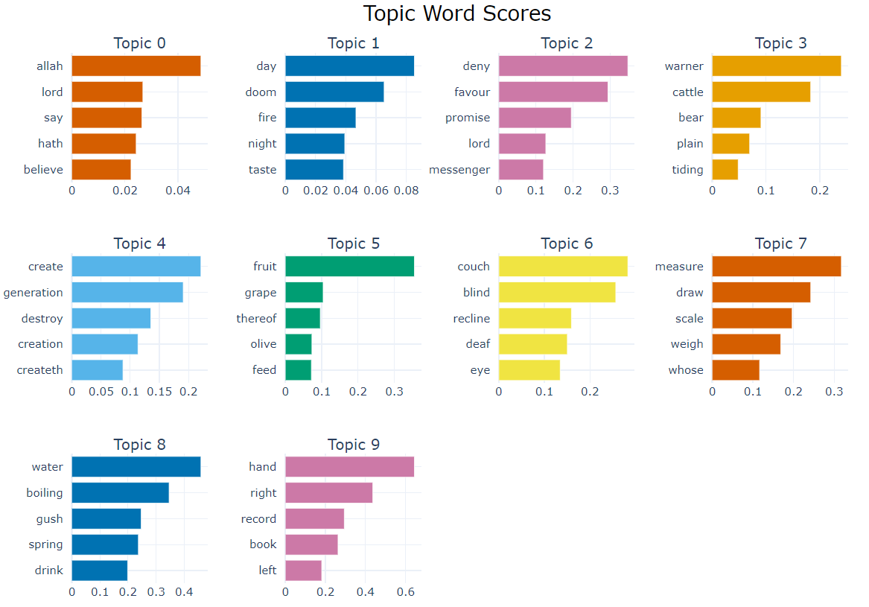
RESULTS
TOPIC WORD SCORES for QURAN using BERTTOPIC

Slide 23
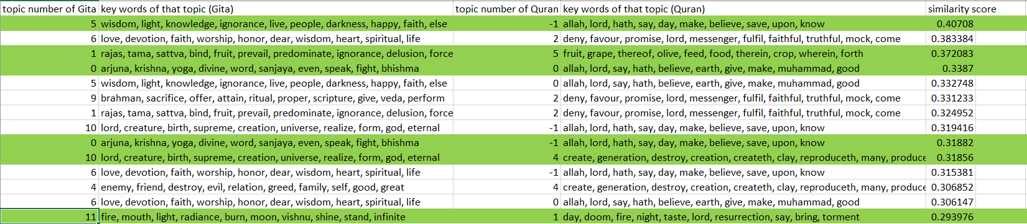
RESULTS
TOPIC SIMILARITY BETWEEN GITA vs QURAN using BERTTOPIC

Slide 24
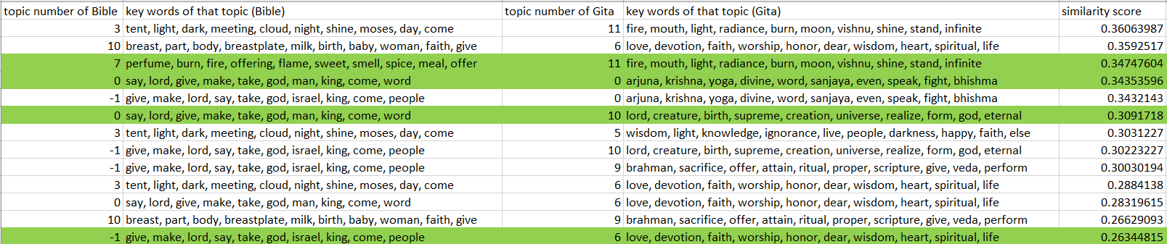
RESULTS
TOPIC SIMILARITY BETWEEN GITA vs BIBLE using BERTTOPIC

Slide 25
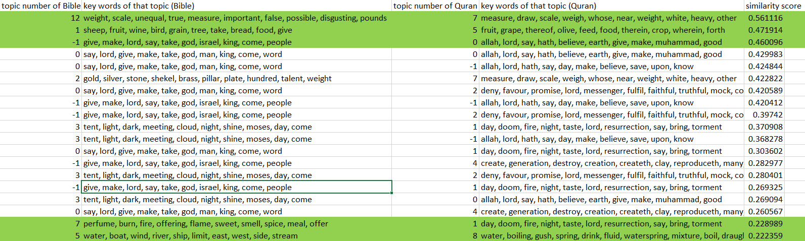
RESULTS
TOPIC SIMILARITY BETWEEN BIBLE vs QURAN using BERTTOPIC

Slide 26
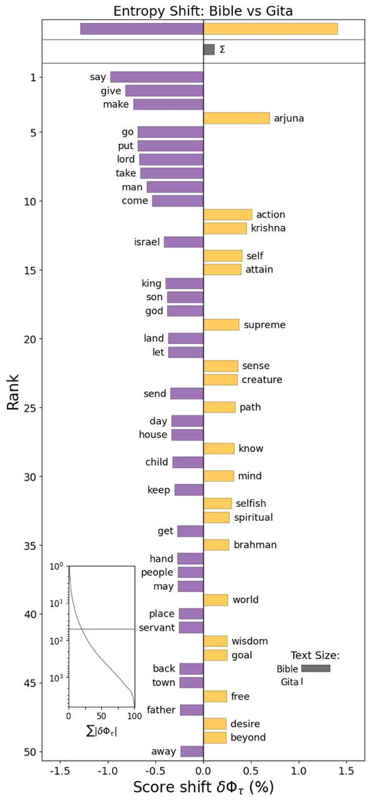
RESULTS
ENTROPY SHIFT GRAPHS BETWEEN GITA vs BIBLE

Slide 27
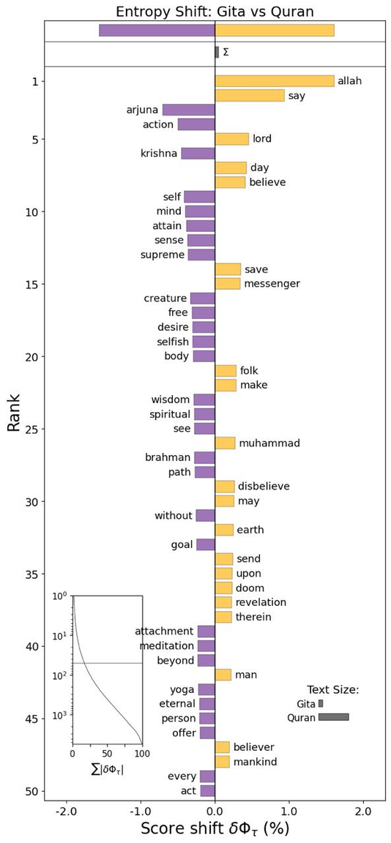
RESULTS
ENTROPY SHIFT GRAPHS BETWEEN GITA vs QURAN

Slide 28
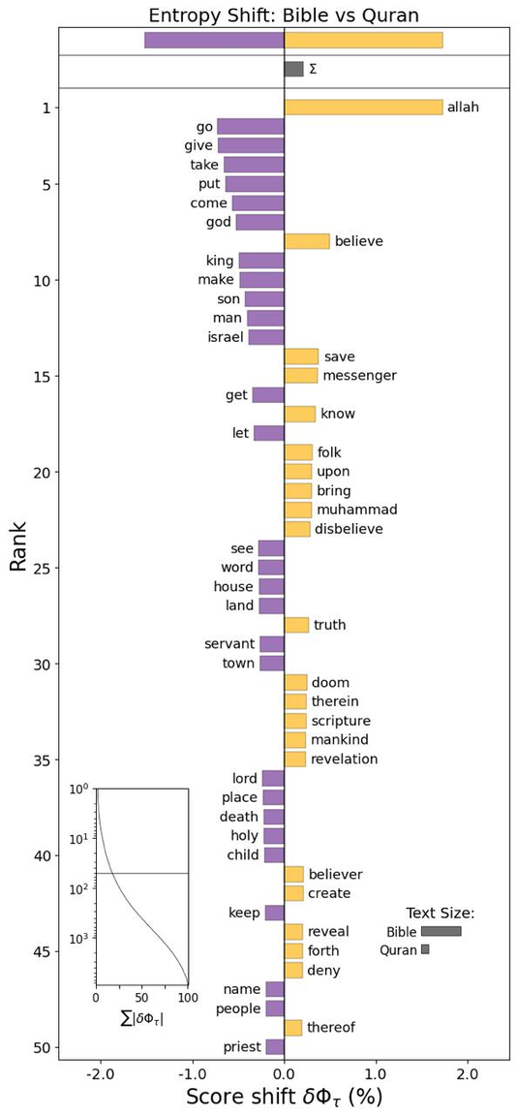
RESULTS
ENTROPY SHIFT GRAPHS BETWEEN BIBLE vs QURAN

Slide 29
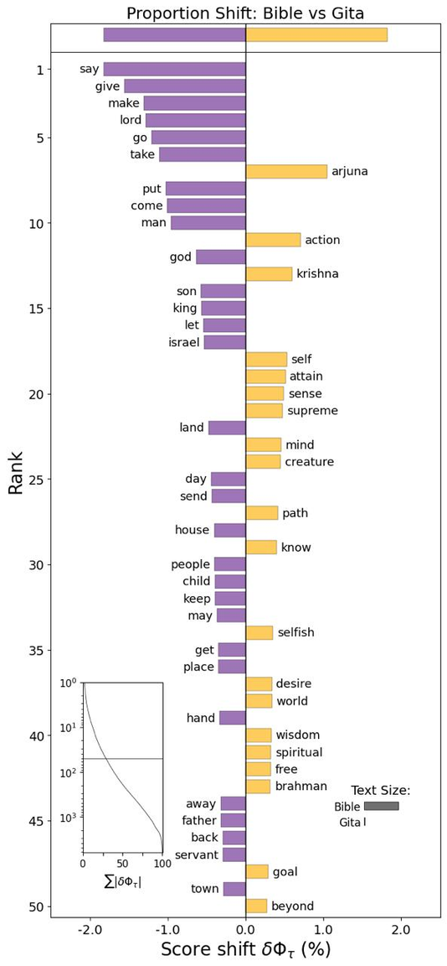
RESULTS
PROPORTION SHIFT GRAPHS BETWEEN GITA vs BIBLE

Slide 30
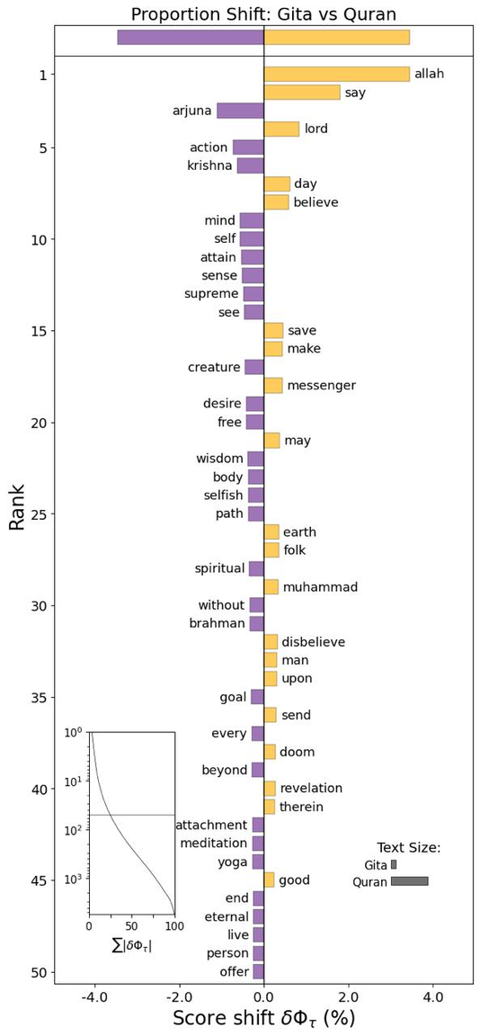
RESULTS
PROPORTION SHIFT GRAPHS BETWEEN GITA vs QURAN

Slide 31
RESULTS
PROPORTION SHIFT GRAPHS BETWEEN BIBLE vs QURAN

Slide 32
RESULTS
Corpus Distance Measures in Religious Texts
1. FRÉCHET INCEPTION DISTANCE (FID) – NO EMBEDDINGS
FID (Bible vs Gita): 0.387 (Lower means closer)
FID (Bible vs Quran): 0.166
FID (Gita vs Quran): 0.380
2. COSINE SIMILARITY (AVERAGED EMBEDDINGS)
Bible vs Gita: 0.728
Bible vs Quran: 0.898
Gita vs Quran: 0.776

Slide 33
RESULTS
Corpus Distance Measures in Religious Texts
3. CENTROID COMPARISONS
Cosine Similarity (Average):
Bible vs Gita: 0.542
Bible vs Quran: 0.704
Gita vs Quran: 0.623
Euclidean Distance (Average):
Bible vs Gita: 0.528
Bible vs Quran: 0.417
Gita vs Quran: 0.491

Slide 34
RESULTS
Sentiment Analysis Using VADER
DISCLAIMER:
VADER sentiment analysis assigns scores in the range of [-1, 1]. However, we cannot interpret these scores to be indicative of moral rightness/wrongness in the text. These scores are assigned based on the words in it individually.

Slide 35
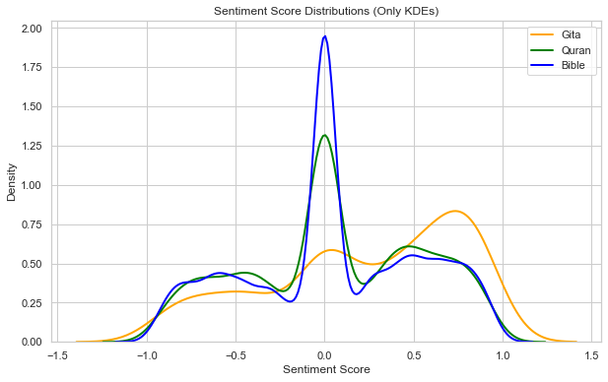
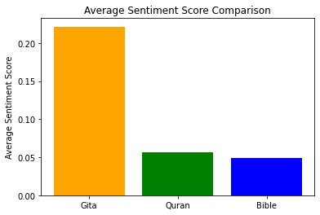
RESULTS
Sentiment Analysis Using VADER

Slide 36
RESULTS
Sentiment Analysis w.r.t Modern Topics
TOPICS:
Gender roles and gender equality
Violence, war, peace, and forgiveness
Slavery, human rights, and dignity
Religious tolerance, interfaith relations, and apostasy
Freedom of speech and expression
Marital relations and sexuality
Wealth, greed and charity
Environment, preservation, and sustainability
Criminal justice, law, and punishment
Science, knowledge, and rationality

Slide 37
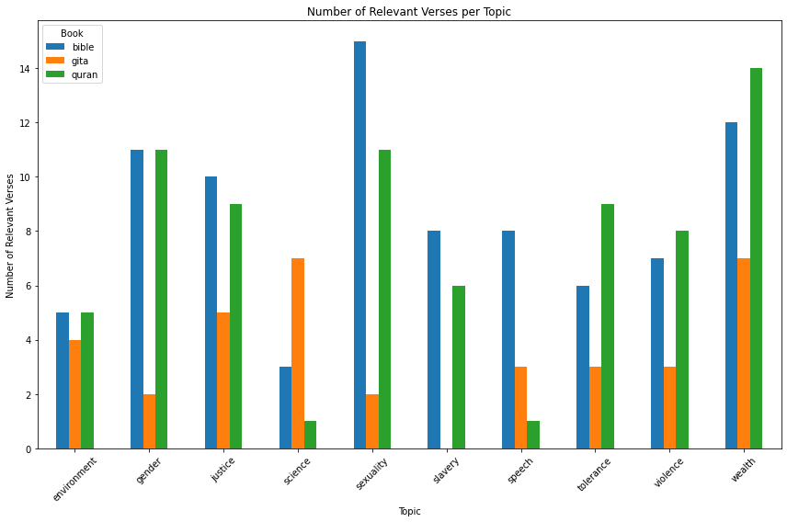
RESULTS
Sentiment Analysis w.r.t Modern Topics

Slide 38
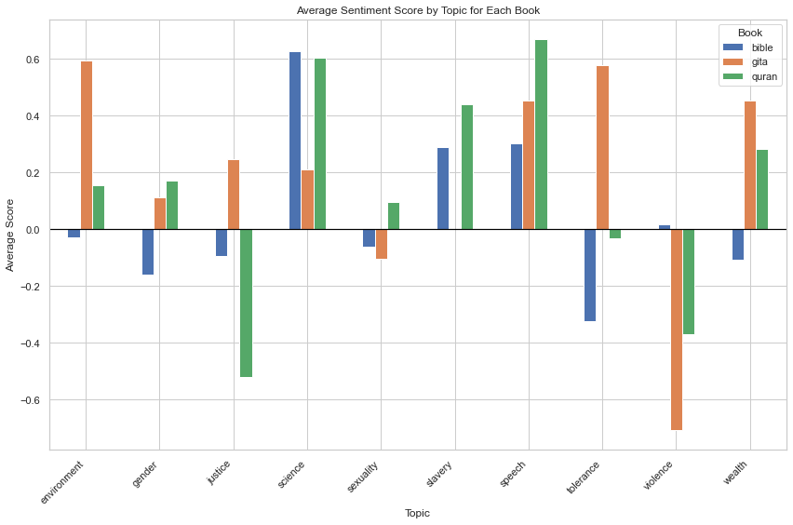
RESULTS
Sentiment Analysis w.r.t Modern Topics

Slide 39
THANK YOU

